Slide 1
A Brief History of Surveillance State Technology
Matthew Jones
mjones@columbia.edu
@nescioquid

Slide 2
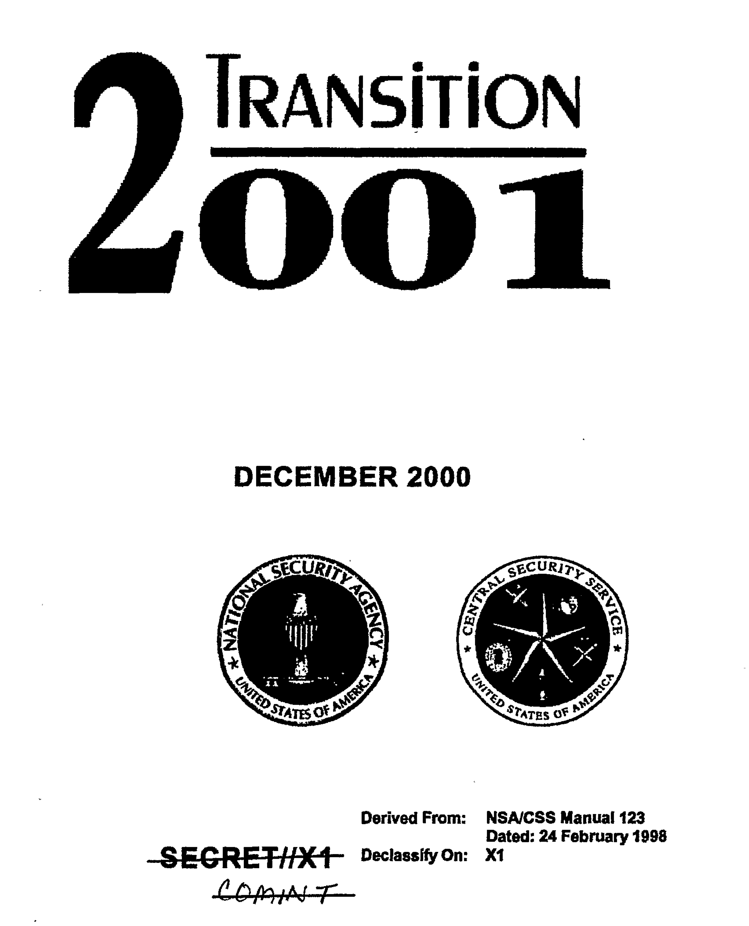
NSA 2001
The Fourth Amendment is as applicable to eSIGINT as it is to the SIGINT of yesterday and today. The Information Age will however cause us to rethink and reapply the procedures, policies and authorities born in an earlier electronic surveillance environment.

Slide 3
Tech. determinism = bunk
Technology does not itself imply any particular law or policy.
Many like to claim so.

Slide 4
“modernizing” the law
Telephones/Internet metadata
Computer Espionage Hacking

Slide 5
Exploiting
“Exploit” means, on first approximation, “make available” or “enable”
  To exploit Angela Merkel’s cellphone is to make the acquisition of her telephony metadata and content possible
“Exploiting the law” means allowing the law to enable surveillance and analysis

Slide 6
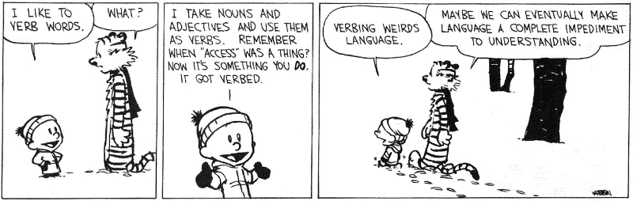
Verbing weirds language

Slide 7
After Snowden
Breadth
Depth

Slide 8
NSA >9/11: domestic “breadth”
Breadth
  Systematic collection of domestic telephony and (until lately) internet metadata
  Able to collect large numbers of communications into, out of, and traversing the US
  Including a large number of “incidental” communications of US persons

Slide 9
NSA >9/11: “depth” abroad
not just foreign leaders, militaries, and intelligence; narcos
not just the communications passing between phones or computers, but access to the full contents of computers, phones and routers themselves of millions of people and organizations
Banality of hacking
  Millions of devices systematically scanned as exploitable
  “lightweight implants” used to map internal networks just in case
  “enable” other activities

Slide 10
= COMPROMISED COMPUTER/ROUTER/ETC.

Slide 11
“in ur interwebz, sploiting ur dataz”
NSA talk title, August 2008

Slide 12
History? Snore.
Why bother?
Don’t want just
  personality driven account (Cheney, Hayden, Alexander)
  executive power—Art. II (John Yoo &c.)
  monotonic government power
  revolving door corruption (NSA←→contractors)
Structural account of earlier possibilities put to use after 9/11

Slide 14
NSA 2001
The Fourth Amendment is as applicable to eSIGINT as it is to the SIGINT of yesterday and today. The Information Age will however cause us to rethink and reapply the procedures, policies and authorities born in an earlier electronic surveillance environment.

Slide 15
4th revised
Make no mistake, NSA can and will perform its missions consistent with the Fourth Amendment . . . senior leadership must understand that today’s and tomorrow’s mission will demand a powerful, permanent presence on a global telecommunications network that will host the ‘protected’ communications of Americans as well as the targeted communications of adversaries.
National Security Agency/Central Security Service, “National Security Agency/Central Security Service Transition 2001”, p. 32.

Slide 16
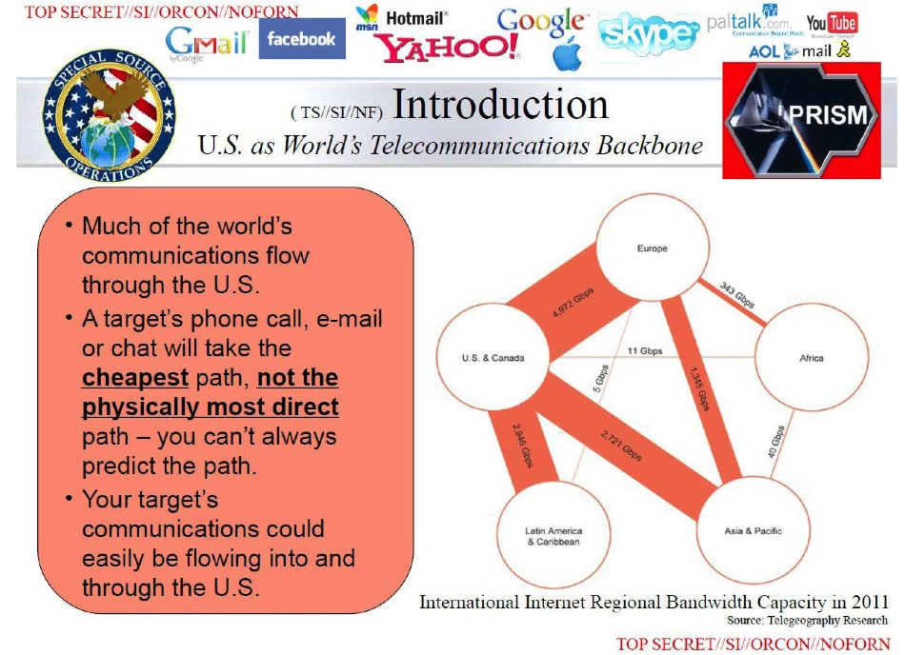
Transiting US

Slide 17
“modernizing” the law
  Non-US signals in the “homeland”
  Foreign communications transiting the homeland
  Domestic launching points for information warfare from foreign sources

Slide 18
“modernizing” the law
  Non-US signals in the “homeland”
  Foreign communications transiting the homeland
  Domestic launching points for information warfare from foreign sources
1) Impossibility of treating as domestic law enforcement subject to 4th Amendment
2) Necessity to treat as defense issue in the first instance

Slide 20
NSA 2001
The Fourth Amendment is as applicable to eSIGINT as it is to the SIGINT of yesterday and today. The Information Age will however cause us to rethink and reapply the procedures, policies and authorities born in an earlier electronic surveillance environment.

Slide 21
“The Information Age,” huh?
The issue of domestic intelligence gathering and surveillance needs to be revisited. […] intelligence gathering and surveillance are the first line of deterrence and defense against all forms of cyberattack.
[CSIS Homeland Defense: Information Warfare, p. 191]

Slide 22
Block Periodization

Slide 23

Toffler

Slide 24
Two regimes of conflict
Ye olde Westphalian order:
  Among sovereign, territorial nations
    some (US) with robust formal rights for citizens (US persons)
    Externally focused forces (DOD, NSA, CIA, MI-6, &c)
    Domestically focused forces (FBI, MI-5, &c.)
    “Hobbesian” or “Grotian” relations among nations

Slide 25
Two regimes of conflict
De-territorialized, non-Westphalian, Information age
  Porous nations and non-state actors
    “homeland” no “sanctuary”
  Asymmetrical warfare anywhere
    Dissolving of Defense/law enforcement boundary
    Dissolving of foreign/not foreign

Slide 26
“Loss of sanctuary” in 1990s
Center for Strategic and International Studies
Critical Infrastructure Protection
commission
Defense Science Board
RAND’s The Day After in Cyberspace…
Hart-Rudman Commission
Presidential Directives 62-63
Clancy, Debt of Honor
Toefflers, War and Anti War
In the new era, a sharp distinction between ‘foreign’ and ‘domestic’ no longer apply. We do not equate national security with ‘defense.’” (Hart-Rudman, Roadmap to National Security)

Slide 27
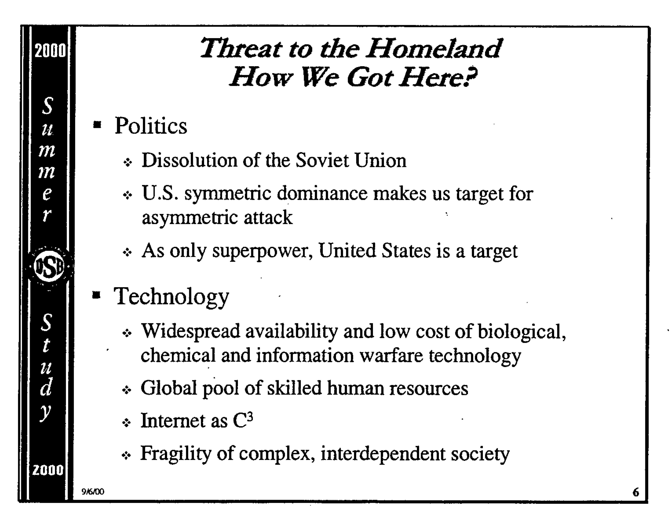
Loss of sanctuary
“Information war has no front line. Potential battlefields are anywhere networked systems allow access. […]
the U.S. homeland may no longer provide a sanctuary from outside attack.”
--RAND report on Cyberwar exercises
“What Makes Cyberwar Different?”
DSB Summer Study 2000

Slide 28
Loss of sanctuary
DSB 2001 report (< 9/11/2001)
Because the targets of information operations will be civilian as well as military, defending against such attacks will require close cooperation [….] Such cooperation is mildly controversial today, but a sophisticated attack on public and private networks will likely make cooperation not just politically acceptable but politically necessary. When that happens, the legal regime needed to respond to the attack will likely be put in place quickly by politicians anxious to be seen as part of the solution. [85-86]
NSA Cryptolog Magazine,1997

Slide 29
“modernizing” < 9/11
Deterritorializing regime working within constitutional one
Setting wheels in motion to
  Allow interception of foreign packets transiting US
  Weaken intelligence / domestic crime boundary
  Allow NSA to play significant role in scanning US networks looking for vulnerabilities or attacks in action (Critical Information Infrastructure)
  Allow NSA, CIA, and DOD more involvement in fighting asymmetric warfare in US more generally

Slide 30
“modernizing” < 9/11
Deterritorializing regime working within constitutional one
Setting wheels in motion to
  Allow interception of foreign packets transiting US
  Weaken intelligence / domestic crime boundary
  Allow NSA to play significant role in scanning US networks looking for vulnerabilities or attacks in action (Critical Information Infrastructure)
  Allow NSA, CIA, and DOD more involvement in fighting asymmetric warfare in US more generally
PATRIOT ACT emerges with weeks of 9/11

Slide 31
Contested < 9/11
Letter to Gore, 11/8/1995, on encryption policy

Slide 32
Contested < 9/11
Letter to Gore, 11/8/1995, on encryption policy

Slide 33
Contested < 9/11
Clinton era Office of Legal Counsel in 1997-2000
  Sharply uphold boundary between
    Domestic law enforcement
      Grand juries
      Wiretaps
    Intelligence Community
  Reject plan to contact-chain US persons
    (has anyone succeeded in FOIAing this? I got nuttin’)

Slide 34
Contested < 9/11
Clinton era Office of Legal Counsel in 1997-2000
  Sharply uphold boundary between
    Domestic law enforcement
      Grand juries
      Wiretaps
    Intelligence Community
  Reject plan to contact-chain US persons
    (has anyone succeeded in FOIAing this? I got nuttin’)
PATRIOT ACT UNDOES

Slide 35
Post-westphalian data mining
“the application of evolving techniques that already are employed widely in the industrial sector for searching, merging, sorting and correlating data in multiple independent data bases, can be applied to the transnational terrorist problem to provide intelligence analysts with more effective tools than are now available to help them discover the identities, capabilities, intentions and plans, of foreign and domestic threat groups.”
        Hermann and Welch, The Defense Science Board 1997 Summer Study Task Force on DoD Responses to Transnational Threats. Volume III (Supporting Reports), section 4A, p. 6.

Slide 36

Total Information Awareness
Complete Irony Unawareness Office
LACK OF IRONY A REASONED FACT NOT JUST A FACT

Slide 38
Exploiting the law
Making up Metadata
Computer Network Exploitation

Slide 39
Exploiting the law
Making up Metadata

Slide 40
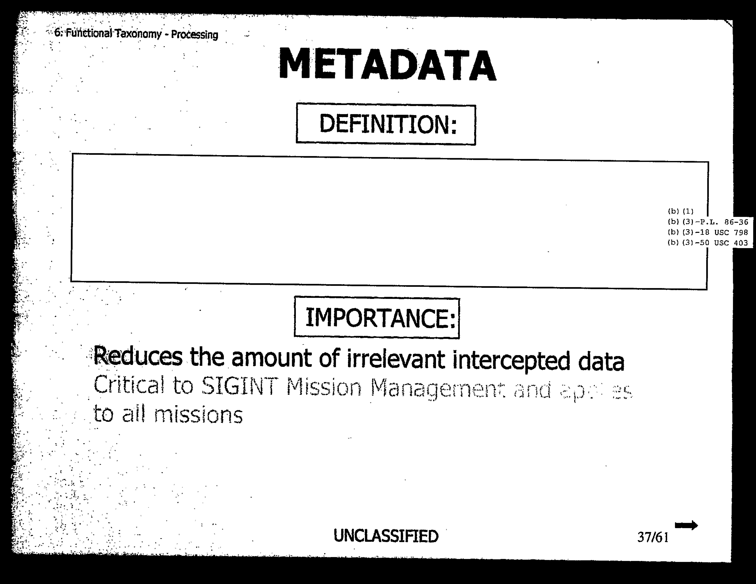
Definition too secret…

Slide 41
From Calls to Metadata
Warrantless wiretapping
Pen register “use technology reasonably available to it that restricts the recording or decoding of electronic or other impulses to the dialing and signaling information utilized in call processing.”
PATRIOT §216
“the recording or decoding of electronic or other impulses to the dialing, routing, addressing, and signaling information utilized in the processing and transmitting of wire or electronic communications so as not to include the contents of any wire or electronic communications.”

Slide 42
Bifurcation of “communications”
Metadata (still unnamed in PATRIOT Act)
Content (delimited and specific)
FBI fact sheet “Section 216 updated the law to the technology. It ensures that law enforcement will be able to collect non-content information about terrorists' communications regardless of the media they use.”

Slide 43
Smith v. Maryland (1979)
Supreme Court held that individual users of telephony have no “reasonable expectation of privacy” in the phone numbers they dial even as they have a reasonable expectation of privacy in the spoken content of their calls.

Slide 44
Smith v. Maryland, exploited
Supreme Court held that users of telephony have no “reasonable expectation of privacy” in the phone numbers they dial ^{their communications metadata} even as they have a reasonable expectation of privacy in the content of calls ^{their communications}.

Slide 45
Aggregation and privacy interests
A later ruling:
“[…] where one individual does not have a Fourth Amendment interest, grouping together a large number of similarly-situated individuals cannot result in the Fourth Amendment interest springing into being ex nihilo.”
Amended Memorandum Opinion, 8–9 (Foreign Intelligence Surveillance Court 2013), 8.

Slide 46
Two forms of aggregation
Classical UG stats
Data mining
Aggregation yield generalization
  Means
  Medians
  Std. deviations
  No privacy interest
Aggregation allow to know individual better
  (at least to predict many qualities about that person)
  Massive privacy interest
  FELTON ACLU AMICUS!

Slide 47
Traffic Analytic Revolution
“[…] the break between the Black Chambers and modern cryptology is the invention of traffic analysis, the recognition that cryptologic attack can reveal information of value even when it is successful only in recovering the externals of intercepted communications.”
        redacted, P054, “Intelligence Analysis: Production and Reporting in a Changed Environment,” Cryptolog: The Journal of Technical Health, no. 1 (1995): 20.

Slide 48
SigInt
Cryptographic Analysis
Traffic analysis
Decrypting plain text of contents of communication
What NSA famous for
Reconstructing Networks of Communication, Order of Battle, etc.
WITHOUT access to CONTENT of communications

Slide 50
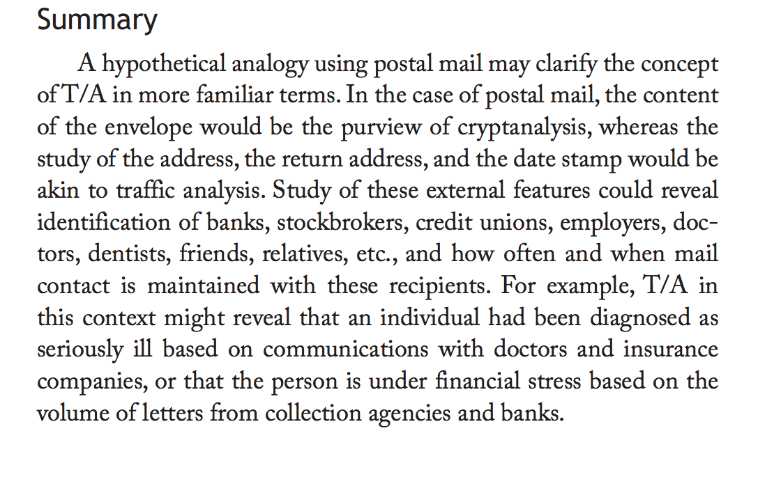
Envelopes & T/A
Crucial old discipline in NSA:
Study externals of communications to understand order of command

Slide 51
12333 annex
Classified annex to DOD interp of EO 12333, 1988

Slide 52
TA from cold war to present
Cold War T/A
Post-Westphalian T/A
Electronic order of battle
All military, diplomatic, and political communications
Threats hidden “in the homeland”
Massively asymmetric
Potentially all communications

Slide 54
Exploiting the law
Computer network attack exploitation

Slide 55
Talking point
Caitlin Hayden, Obama spokesperson:
“The United States has made clear it gathers intelligence in exactly the same way as any other states.”
ROC Motto: “Your data is our data, your equipment is our equipment—anytime, any place, by any legal means.”

Slide 56
= COMPROMISED COMPUTER/ROUTER/ETC.

Slide 57
Information Warfare 1.0
Warfare include “exploitation, corruption, or destruction”

Slide 58
Computer Network Attack: a bit of honesty

Slide 59
Computer Network Attack: euphemism
JP3-13, 1996, p. II-8

Slide 60
“warfare”
“exploitation”
Creation of new category c. 1997-8 [??]
computer network exploitation [CNE]— “Enabling operations and intelligence collection capabilities conducted through the use of computer networks to gather data from target or adversary automated information systems or networks.”
Such cracking not offensive warfare—a tertium quid

Slide 61
CNE as espionage
The treatment of espionage under international law may help us make an educated guess as to how the international community will react to information operations activities. . . . If the activity results only in a breach of the perceived reliability of an information system, it seems unlikely that the world community will be much exercised.”
  Johnson, “An Assessment of International Legal Issues in Information Operations,” 40.
  Gov’t contractors produce series of legal guides….

Slide 62
A funny kind of espionage..
“First, espionage used to be a lot more difficult. Cold Warriors did not anticipate the wholesale plunder of our industrial secrets. Second, the techniques of cyber espionage and cyber attack are often identical, and cyber espionage is usually a necessary prerequisite for cyber attack.”
[1] Scale of espionage
[2] Non-distinctiveness

Slide 63
A funny kind of espionage..
“Cyber espionage, far from being simply the copying of information from a system, ordinarily requires some form of cyber maneuvering that makes it possible to exfiltrate information. That maneuvering, or “enabling” as it is sometimes called, requires the same techniques as an operation that is intended solely to disrupt.”
…. Often, the only difference between military cyber operations intended to collect intelligence and those designed to deliver cyber effects is the intent…”

Slide 64
A funny kind of espionage..
Which tenured radicals?
Gary D. Brown Colonel, USAF (ret.). Senior Legal Advisor at U.S. Cyber Command, 2010-2012.
Andrew O. Metcalf Lieutenant Colonel, USMC. Senior Legal Advisor to U.S. Marine Corps Forces Cyberspace Command.
“Cyber espionage, far from being simply the copying of information from a system, ordinarily requires some form of cyber maneuvering that makes it possible to exfiltrate information. That maneuvering, or “enabling” as it is sometimes called, requires the same techniques as an operation that is intended solely to disrupt.”
…. Often, the only difference between military cyber operations intended to collect intelligence and those designed to deliver cyber effects is the intent…”

Slide 66

Janus Faced Agency
SigInt
Information Assurance
Exploit communications
Protect Communications
(COMSEC)

Slide 67
Janus Faced Agency
SigInt
Information Assurance
Exploit communications
Protect Communications
(COMSEC)
One of the biggest challenges we face is balance the two [missions]… The systems or techniques we develop have the capacity to come back on us in the form of increasingly sophisticated target systems. [….] How to draw a policy to balance those two issues is extremely important to our continued success—on both sides.
“Confronting the Intelligence Future (U) An Interview with William P. Crowell, NSA's Deputy Director (U)”

Slide 69
NSA then and now
“NSA Valued in the 1980s, Accuracy, Deep Knowledge, Thorough expertise, Productivity and Reputation […].”
“NSA valued in the 2000s […] Speed-getting it 80 percent right now could make all the difference in saving lives. (Of course, if it were targeting information that would mean killing innocents 20 percent of the time.)”
    redacted, “NSA Culture, 1980s to the 21st Century--a SID Perspective,” Cryptological Quarterly 30, no. 4 (n.d.): 84.

Slide 70
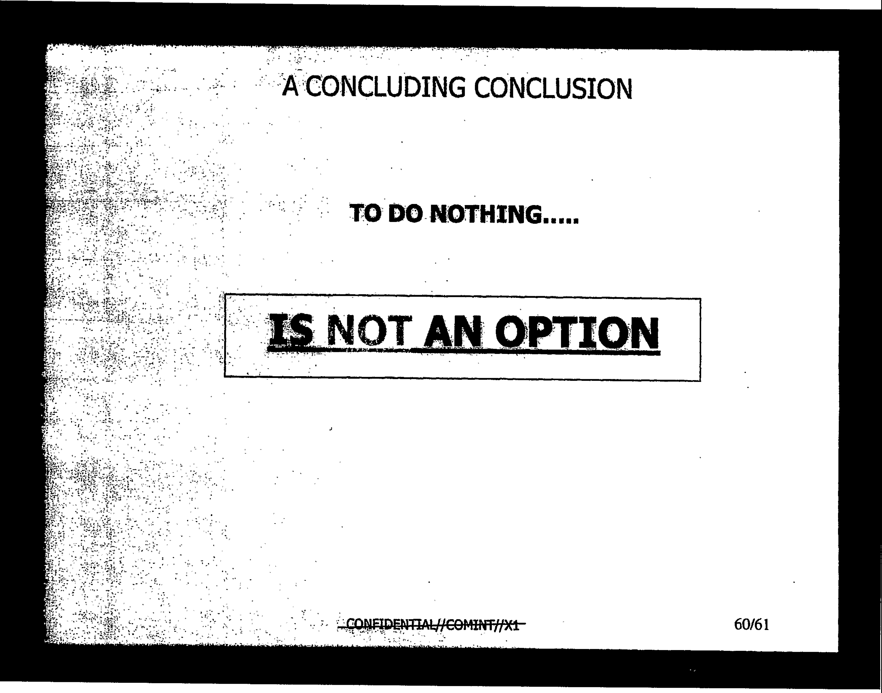
NSA 1980s vs. 2000s
“NSA Valued in the 1980s, Accuracy, Deep Knowledge, Thorough expertise, Productivity and Reputation […].”
In the asymmetric world of a dizzying array of potential enemies: “NSA valued in the 2000s […] Speed-getting it 80 percent right now could make all the difference in saving lives. (Of course, if it were targeting information that would mean killing innocents 20 percent of the time.)”

Slide 71
“Cyber collection”
Operations and related programs or activities conducted by or on behalf of the United States Government, in or through cyberspace, for the primary purpose of collecting intelligence. . . .from computers, information or communications systems, or networks with the intent to remain undetected. Cyber collection entails accessing a computer, information system, or network without authorization from the owner or operator of that computer, information system, or network or from a party to a communication or by exceeding authorized access. Cyber collection includes those activities essential and inherent to enabling cyber collection, such as inhibiting detection or attribution, even if they create cyber effects.”
“Presidential Policy Directive (PPD)-20: U.S. Cyber Operations Policy,” 2–3.

Slide 72
“Cyber effects”
“The manipulation, disruption, denial, degradation, or destruction of computers, information or communications systems, networks, physical or virtual infrastructure controlled by computers or information systems, or information resident thereon.”
Espionage, then, often will be attack in all but name.

